Slide 1
COMP 4290
Week 4 - Wednesday

Slide 2
Last time
What did we talk about last time?
Secure encryption algorithms
DES
Started AES

Slide 3
Questions?

Slide 4
Project 1

Slide 5
Kyle Hinkle Presents

Slide 6
Back to AES

Slide 7
AES internals
AES keeps an internal state of 128 bits in a 4 × 4 table of bytes
There are four operations on the state:
  Substitute bytes
  Shift rows
  Mix columns
  Add round key

Slide 8
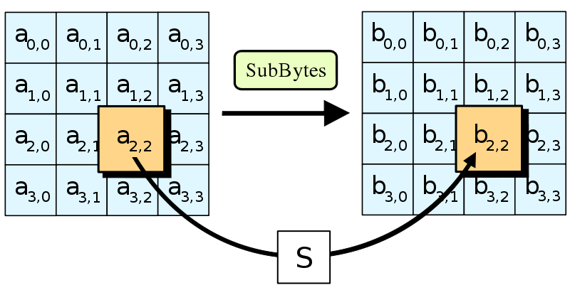
Substitute bytes
Each byte is substituted for some other byte
This operation is similar to the S-box from DES
The substitution is based on the multiplicative inverse of the value in GF(2⁸)
  An algebraic structure is used instead of hand picking substitution value
  0 is used as its own multiplicative inverse
To break up patterns, the result of finding the multiplicative inverse is XORed with the value 99
| 0 1 2 3 4 5 6 7 8 9 a b c d e f
---|--|--|--|--|--|--|--|--|--|--|--|--|--|--|--|--| 00 |63 7c 77 7b f2 6b 6f c5 30 01 67 2b fe d7 ab 76 10 |ca 82 c9 7d fa 59 47 f0 ad d4 a2 af 9c a4 72 c0 20 |b7 fd 93 26 36 3f f7 cc 34 a5 e5 f1 71 d8 31 15 30 |04 c7 23 c3 18 96 05 9a 07 12 80 e2 eb 27 b2 75 40 |09 83 2c 1a 1b 6e 5a a0 52 3b d6 b3 29 e3 2f 84 50 |53 d1 00 ed 20 fc b1 5b 6a cb be 39 4a 4c 58 cf 60 |d0 ef aa fb 43 4d 33 85 45 f9 02 7f 50 3c 9f a8 70 |51 a3 40 8f 92 9d 38 f5 bc b6 da 21 10 ff f3 d2 80 |cd 0c 13 ec 5f 97 44 17 c4 a7 7e 3d 64 5d 19 73 90 |60 81 4f dc 22 2a 90 88 46 ee b8 14 de 5e 0b db a0 |e0 32 3a 0a 49 06 24 5c c2 d3 ac 62 91 95 e4 79 b0 |e7 c8 37 6d 8d d5 4e a9 6c 56 f4 ea 65 7a ae 08 c0 |ba 78 25 2e 1c a6 b4 c6 e8 dd 74 1f 4b bd 8b 8a d0 |70 3e b5 66 48 03 f6 0e 61 35 57 b9 86 c1 1d 9e e0 |e1 f8 98 11 69 d9 8e 94 9b 1e 87 e9 ce 55 28 df f0 |8c a1 89 0d bf e6 42 68 41 99 2d 0f b0 54 bb 16

Slide 9
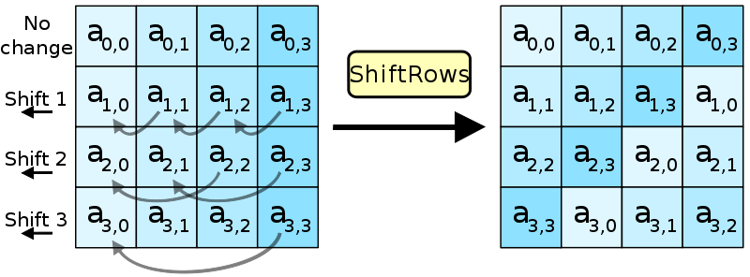
Shift rows
For 128-bit blocks (those used in AES), the rows are shifted by a set amount
  Row 1 is not shifted at all
  Row 2 is shifted over by 1 byte
  Row 3 is shifted over by 2 bytes
  Row 4 is shifted over by 3 bytes
Rijndael has slightly different shifts for larger block sizes

Slide 10
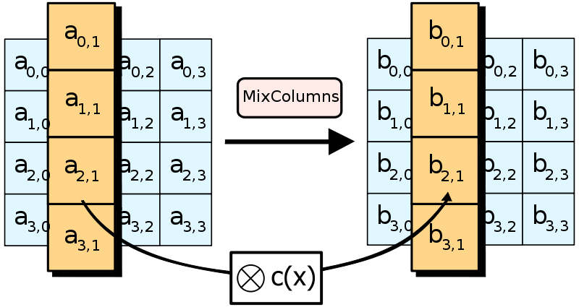
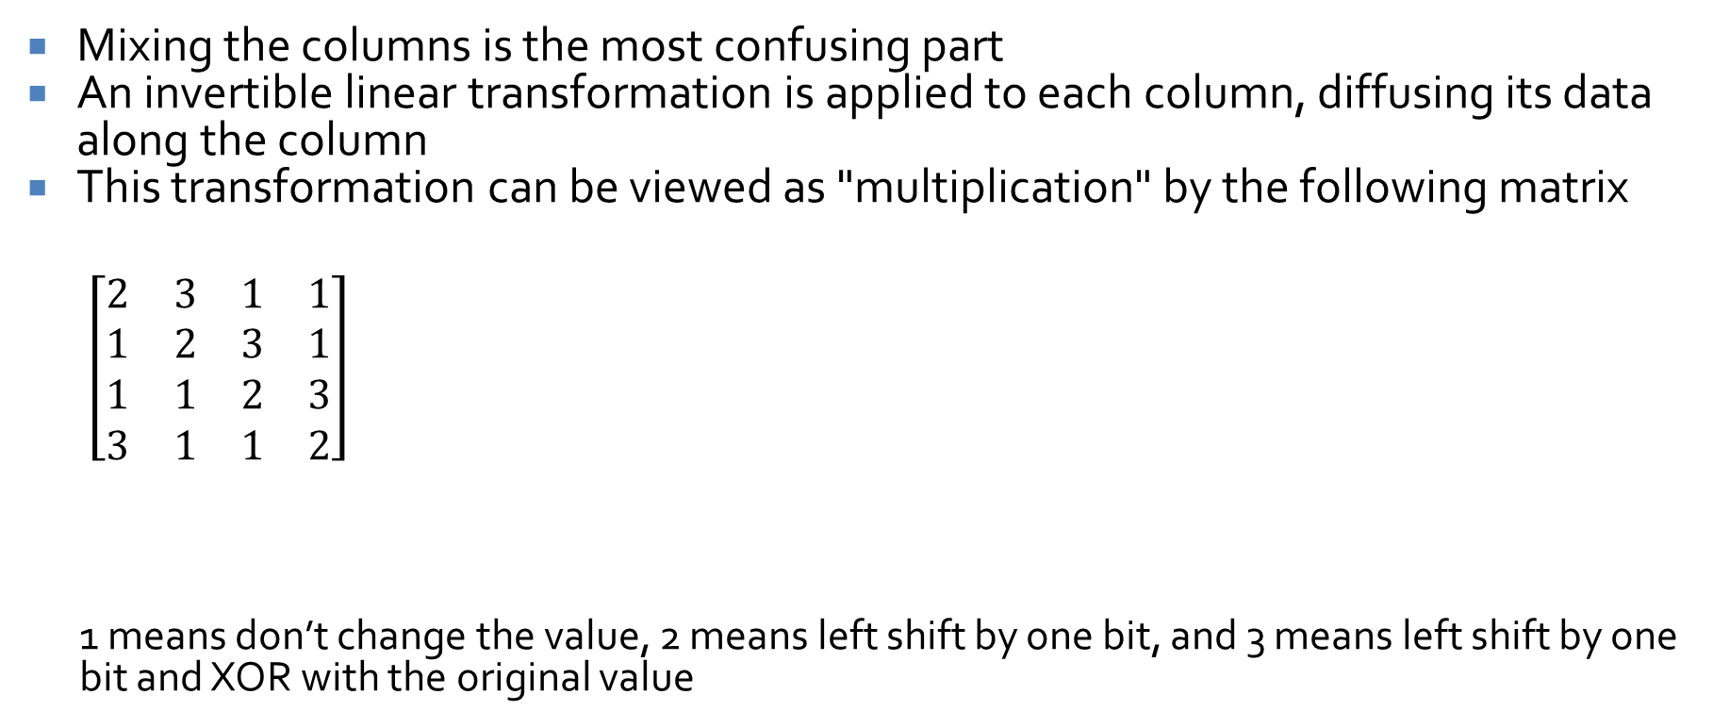
Mix columns
Mixing the columns is the most confusing part
An invertible linear transformation is applied to each column, diffusing its data along the column
This transformation can be viewed as "multiplication" by the following matrix
  $\left[\begin{matrix}2 & 3 & 1 & 1 \\ 1 & 2 & 3 & 1 \\ 1 & 1 & 2 & 3 \\ 3 & 1 & 1 & 2\end{matrix}\right]$
  1 means don’t change the value, 2 means left shift by one bit, and 3 means left shift by one bit and XOR with the original value

Slide 11
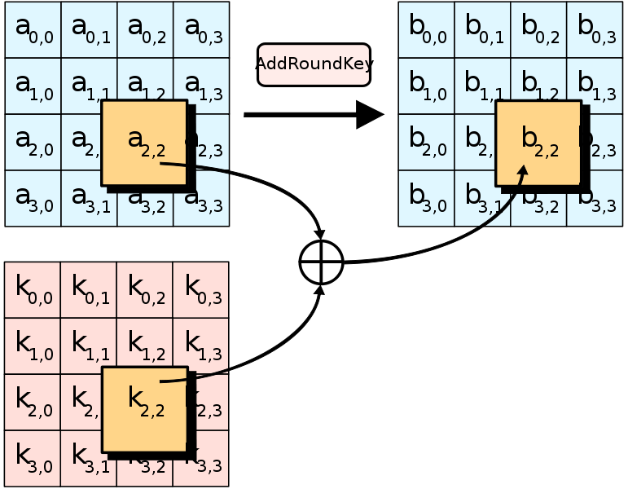
Add key
XOR the current round key with the state
This step is very simple, except that the key schedule that generates the round key from the overall key is complex

Slide 12
AES rounds
AES supports key sizes of 128, 192, and 256 bits
  Rijndael supports unlimited key size, in principle, as well as other block sizes
128-bit keys use 10 rounds, 192 use 12, and 256 use 14
First Round
Normal Round
Last Round
Add round key
Substitute bytes
Shift rows
Mix columns
Add round key
Substitute bytes
Shift rows
Add round key

Slide 13
AES pros and cons
Strengths
  Strong key size
  Fast in hardware and software
  Rich algebraic structure
  Well-studied, open standard
Weaknesses
  Almost none
  A few theoretical attacks exist on reduced-round numbers of AES
  No practical attacks other than side-channel attacks

Slide 14
AES attacks
No practical attacks exist on the full AES
With reduced numbers of rounds and strong attack models, there are some theoretical attacks
  CP = chosen plaintexts
  RK-CP = related key chosen plaintexts
Rounds | Key Size | Data | Time | Year
6 | All | 2³² CP | 2⁷² | 1998
6 | All | 6 ∙ 2³² CP | 2⁴⁴ | 2000
7 | 192 | 19 ∙ 2³² CP | 2¹⁵⁵ | 2000
7 | 256 | 21 ∙ 2³² CP | 2¹⁷² | 2000
7 | All | 2¹²⁸ – 2¹¹⁹ CP | 2¹²⁰ | 2000
8 | 192 | 2¹²⁸ – 2¹¹⁹ CP | 2¹⁸⁸ | 2000
8 | 256 | 2¹²⁸ – 2¹¹⁹ CP | 2²⁰⁴ | 2000
9 | 256 | 2⁸⁵ RK-CP | 2²²⁴ | 2000
12 | 192 | 2¹²³ RK-CP | 2¹⁷⁶ | 2009
14 | 256 | 2^{99.5} RK-CP | 2^{99.5} | 2009
10 | 128 | 2⁸⁸ CP | 2^{126.1} | 2011

Slide 15
Side channel attacks
Attacks that rely on timing, measuring cache, energy consumption, or other ways an implementation leaks data are called side-channel attacks
Several practical side channel attacks for AES do exist
  In 2005, Bernstein found a cache-timing attack that broke an OpenSSL implementation of AES using 200 million chosen plaintexts and a server that would give him precise timing data
  Later in 2005, Osvik et al. found an attack that recovered a key after 800 encryptions in only 65 milliseconds, with software running on the target machine
  In 2009, Saha et al. found an attack on hardware using differential fault analysis to recover a key with a complexity of 2³²
  In 2010, Bangerter et al. found a cache-timing attack that required no knowledge of plaintexts or ciphertexts and could work in about 3 minutes after monitoring 100 encryptions
  In 2016, Ashokkumar et al. found an attack that needs only 6-7 blocks of plaintext and ciphertext and runs in under a minute

Slide 16
AES vs. DES
 | DES | AES
Date | 1976 | 1999
Block size | 64 bits | 128 bits
Key length | 56 bits | 128, 192, 256 bits
Encryption primitives | Substitution, permutation | Substitution, shift, bit mixing
Cryptographic primitives | Confusion, diffusion | Confusion, diffusion
Design | Open | Open
Design rationale | Closed | Open
Selection process | Secret | Secret with public comment
Source | IBM with NSA help | Independent Belgians
Security | Broken if you've got the resources | No practical attacks yet

Slide 17
Public Key Cryptography

Slide 18
Symmetric key cryptography
So far, we have talked about symmetric (or private) key cryptography
In symmetric key cryptography, the same key is used for encryption and decryption
The key is a shared secret
This is perfect for sending messages between two parties who
  Trust each other
  Have shared a secret ahead of time

Slide 19
Public key cryptography
Sometimes, we need something different
We want a public key that anyone can use to encrypt a message to Alice
Alice has a private key that can decrypt such a message
The public key can only encrypt messages; it cannot be used to decrypt messages

Slide 20
Diffie and Hellman
In 1976, Diffie and Hellman proposed the idea of a public key cryptosystem, one in which encryption and decryption keys were different
They gave the following three conditions for such a system:
  It must be computationally easy to encipher or decipher a message given the appropriate key
  It must be computationally infeasible to derive the private key from the public key
  It must be computationally infeasible to determine the private key from a chosen plaintext attack

Slide 21
Public key history
(Whitfield) Diffie and (Martin) Hellman "invented" public key cryptography in 1976
However, James Ellis invented it in 1970, but his work was for a secret British government agency, classified until 1997
Diffie and Hellman came up with the idea of a "trapdoor" function (computationally easy one way, hard the other)
RSA, a practical algorithm published in 1978, made this idea workable
Again, the system had been invented earlier by British intelligence
The guys behind RSA made millions

Slide 22
Number Theory

Slide 23
Prime
RSA depends in large part on the difficulty of factoring large composite numbers (particularly those that are a product of only 2 primes)
Recall that an integer p is prime if
  p > 1
  p is not divisible by any positive integers other than 1 and itself

Slide 24
Fundamental theorem of arithmetic
Any integer greater than 1 can be factored into a unique series of prime factors:
  Example: 52 = 2² ∙ 13
Two integers a and b (greater than 1) are relatively prime or coprime if and only if a shares no prime factors with b

Slide 25
Testing for primality
How do we know if a number is prime?
For small numbers, we can try to divide it by all integers less than or equal to its square root
RSA-768 was successfully factored in December 2009 into 2 primes
  One is: 33478071698956898786044169848212690817704794983713768568912431388982883793 878002287614711652531743087737814467999489
You can't test up to the square root of that in any reasonable time

Slide 26
Efficient primality testing
In 2002, the AKS algorithm was published which demonstrated that it was possible to test to see if a number is prime
  Deterministically
  In time polynomial in the number of digits of the prime
This algorithm is of theoretical interest, but it's too slow for testing the primality of RSA moduli

Slide 27
Rabin-Miller primality testing
We won't get into the number theory behind this (yet)
A Rabin-Miller primality test works as follows:
Let n be the number you want to prove if it's prime or not
  n must be odd, thus n – 1 is even
  (n – 1) = 2^{s}d where s and d are positive integers and d is odd
  If n is prime, then for any integer 1 < a < n, exactly one of the two is true:
    a^{d} ≡ 1 (mod n) or
    a^{2rd} ≡ -1 (mod n), 1 ≤ r < s
  Pick several a values, see if either of the two cases hold
  If it ever doesn't, you know you have a composite

Slide 28
Rabin-Miller example
What if we want to see if 221 is prime?
n – 1 = 220 = 2²∙55
s = 2
d = 55
Attempt 1: Let a = 174
  a^{20·d} mod n = 174⁵⁵ mod 221 = 47 ≠ 1, n − 1
  a^{21·d} mod n = 174¹¹⁰ mod 221 = 220 = n − 1 Check!
Attempt 2: Let a = 137
  a^{20·d} mod n = 137⁵⁵ mod 221 = 188 ≠ 1, n − 1
  a^{21·d} mod n = 137¹¹⁰ mod 221 = 205 ≠ n − 1 Oh no!
Every successful attempt means there is only a 25% chance that the number is composite
So, after k attempts, there is a 4^{-k} chance that the number is composite

Slide 29
Ticket out the Door

Slide 30
Upcoming

Slide 31
Next time…
RSA
Public key management
Spencer Wilson presents

Slide 32
Reminders
Office hours from 1:45-4 p.m. today are moved to 3-5 p.m.
Keep reading Sections 2.3 and 12.4
Work on Project 1
  Due this Friday

